Slide 1
University Product Circuits 2
Geraldine Lee
geraldine343@gmail.com
Dr Mark Glickman
drmarkglickman@yahoo.com

Slide 2
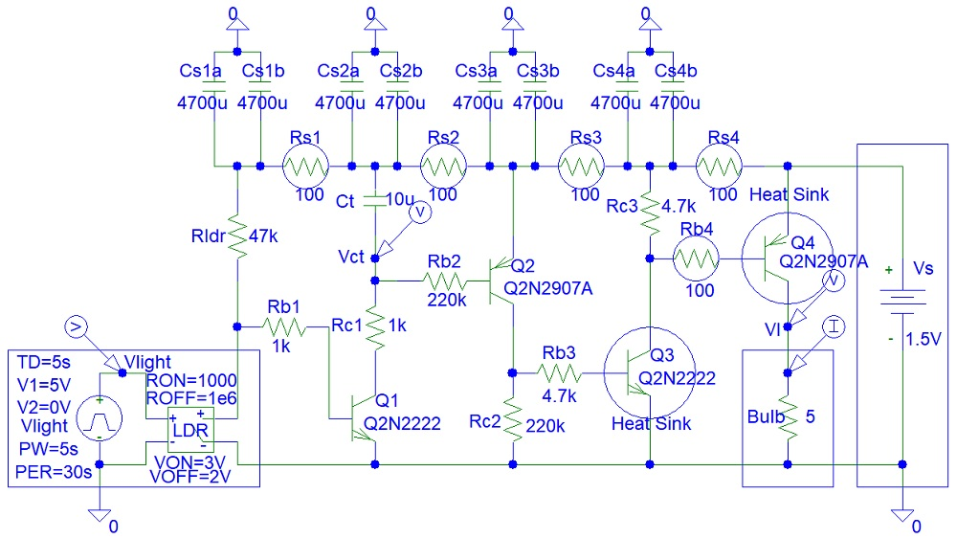
Emergency Lights Schematic

Slide 3
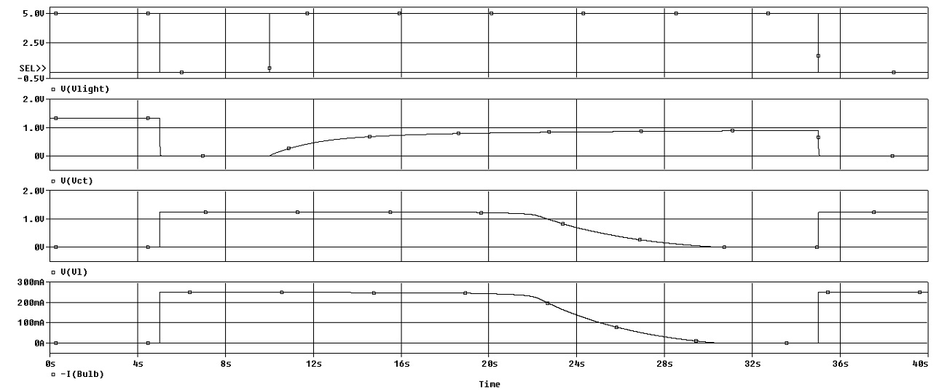
Emergency Lights Simulations
PSpice simulations:

Slide 4
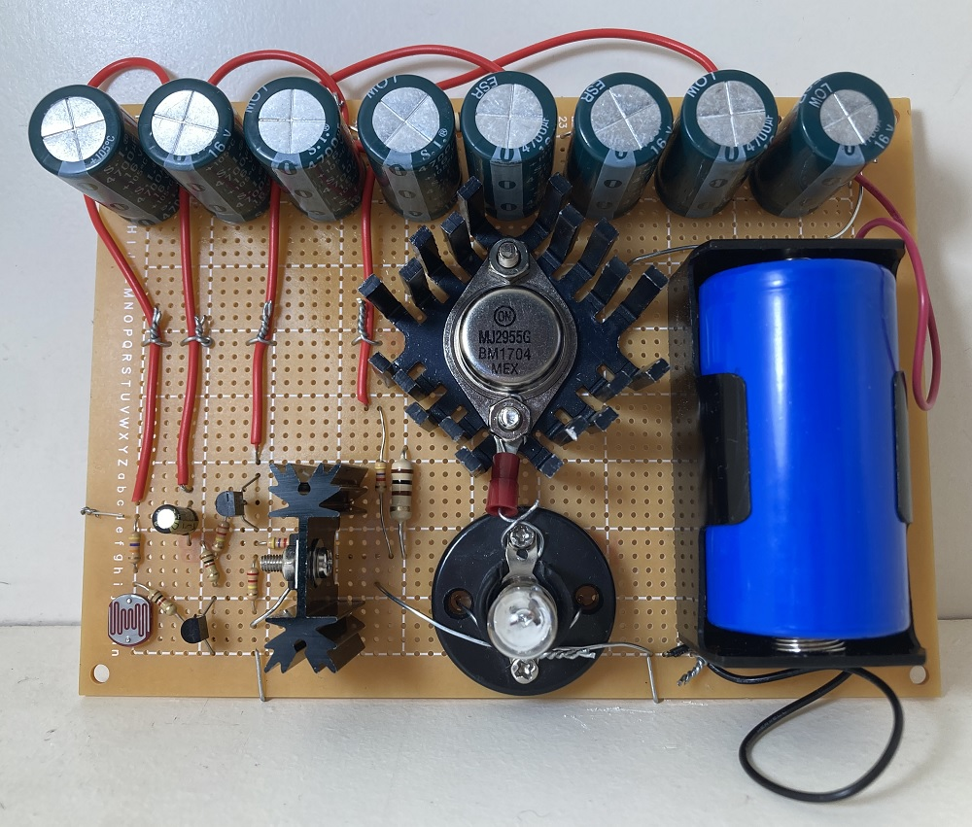
Emergency Lights Circuit

Slide 5
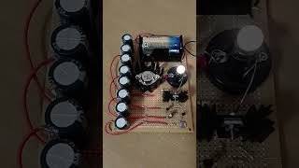
Emergency Lights Video

Slide 6
References
https://instructables.com/member/electriccircuits
https://hackaday.io/electriccircuits
https://instructables.com/member/electroniccircuits
https://hackaday.io/electroniccircuits
https://instructables.com/member/analogueelectronics
https://hackaday.io/analogueelectronics
https://instructables.com/member/analogelectronics
https://hackaday.io/analogelectronics
https://instructables.com/member/badcircuits
https://hackaday.io/badcircuits

Slide 7
References
https://instructables.com/member/diyelectronics
https://hackaday.io/diyelectronics
https://instructables.com/member/simplecircuits
https://hackaday.io/simplecircuits
https://instructables.com/member/simplecomponents
https://hackaday.io/simplecomponents
https://instructables.com/member/cheapcircuits
https://hackaday.io/cheapcircuits
https://instructables.com/member/supercircuits
https://hackaday.io/supercircuits

Slide 8
References
https://instructables.com/member/diycircuits
https://hackaday.io/diycircuits
https://instructables.com/member/usedcomponents
https://hackaday.io/usedcomponents
https://instructables.com/member/recycledcircuits
https://hackaday.io/recycledcircuits
https://instructables.com/member/recycledcomponents
https://hackaday.io/recycledcomponents
https://instructables.com/member/lowcostcircuits
https://hackaday.io/lowcostcircuits

